Slide 1


Slide 1
Demand and Sales Forecast & Plan

Slide 2

Slide 2
Objective & Approach
Objective:
Finalize Sales Plan for next 6 months (January 2015 to June 2015) to plan revenue and inventory accordingly.
Approach:
Make use of historical transactional information of sales quantity, revenue and profit for analysis.
Segment this historical sales into 7 geographical markets and 3 customer segments they belong to.
Identify two most consistently profitable market segments and build a forecast model based on monthly aggregated profit values.
Use this model to forecast sales quantity and revenue for next 6 months for these two most profitable market segments only.
2

Slide 3
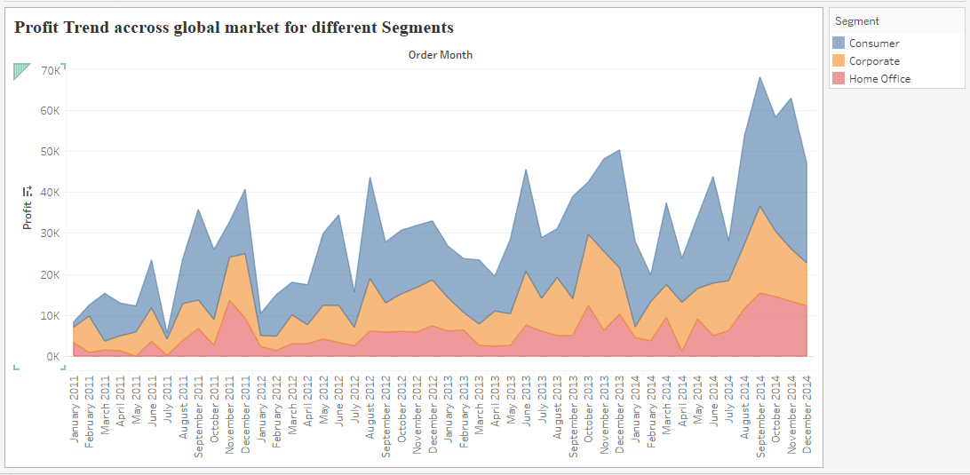
Slide 2
Historical Trend – Profits across Segments
Historical trend of profit across segments indicates that Consumer Segment is consistently most profitable segment as compared to other segments.
Let’s break up profit of Consumer Segment to various Markets.
5

Slide 4
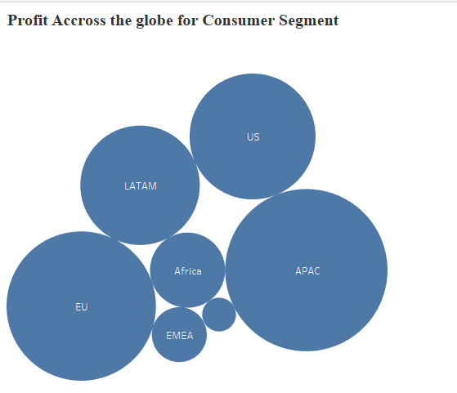
Slide 2
Market-wise Profit across Consumer Segment
EU and APAC are top consistently profitable markets in the Consumer Segment.
Statistical analysis using Coefficient of Variations (CV) confirmed that Consumer Segment for EU and APAC Markets are top 2 consistent market segments.
Forecast for next 6 months would be made for these two market segments only.
5

Slide 5
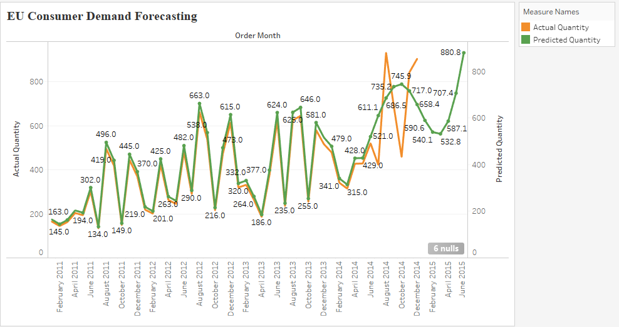
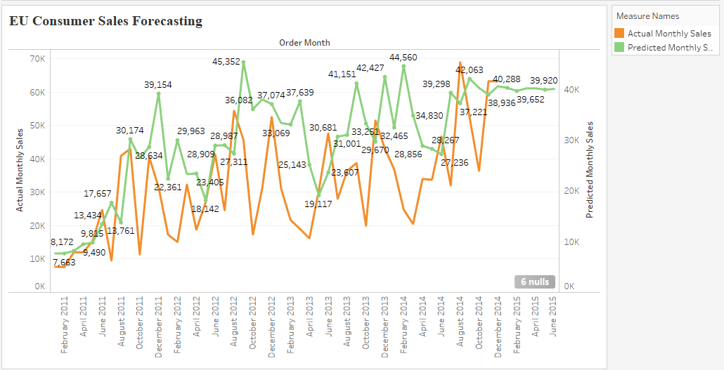
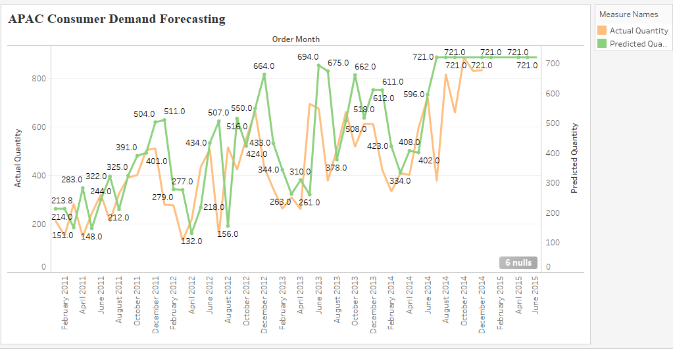
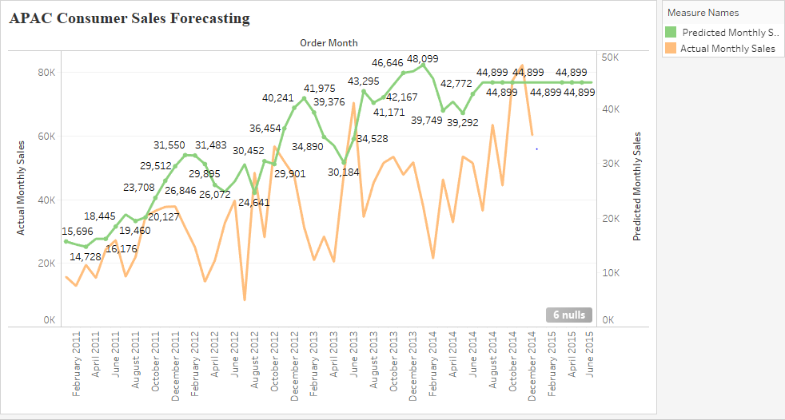
Slide 2
Demand & Sales Revenue Forecast
EU Consumer Segment – Sales Demand and Revenue Forecast for 1st Jan to 30th June 2015
MAPE 30.13%
MAPE 28.92%.
APAC Consumer Segment – Sales Demand and Revenue Forecast for 1st Jan to 30th June 2015
MAPE 26.24%
MAPE 27.69%
6

Slide 6
Slide 2
Business Implications
Demand in EU region for Consumer Segment will hit the trough of seasonal cycle by February 2015 and then will take upward trend.
Sales revenue in EU region for Consumer Segment for the next 6 months will remain relatively stagnant indicating pressure on price and therefore margin.
Demand and Sales Revenue in APAC Consumer Segment for next 6 months seems to be flat throughout.
Overall profit margin for these two most profitable segments will be under pressure and will remain stagnant.
7

Slide 7


Slide 11
THANK YOU

